Slide 1
ES6
23/08/2022 By Prachi Pandya
Notes:
Github demo link: https://github.com/PrachiHP/Internship-2022

Slide 2
Agenda
What is ES6?
ECMAScript versions
JS vs ECMAScript
ES6 features
Questions

Slide 3


Slide 4
What is ES6?
ES6/ ECMAScript 2015/ ECMAScript 6
It is intended to ensure the interoperability of web pages across different browsers
It provides the specification on how JavaScript programming language should work
Allows to make the code more modern and readable
By using ES6 features, we write less and do more
Latest version is ECMAScript 2022

Slide 5
ECMAScript versions
Notes:
https://javascript.info/first-steps

Slide 6
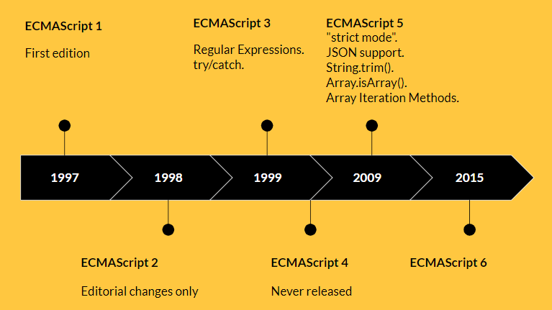

Slide 7
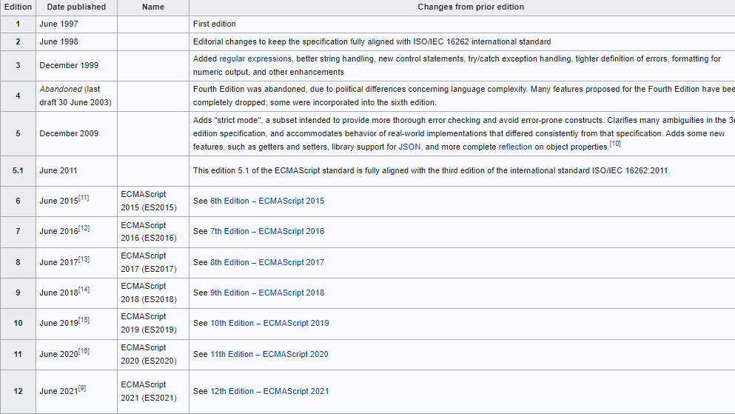

Slide 8
JS vs ECMAScript
Notes:
https://javascript.info/first-steps

Slide 9
JS vs ECMAScript
ES | JS
Specification | Implementation of the ECMAScript standard.
Standard for JS | Light weight interpreted programming language

Slide 10
ES6 features
Notes:
https://javascript.info/first-steps

Slide 11
ES6 features
let and const keywords
Arrow Functions
Multi-line Strings
Template Literals
Parameters handling
Destructuring Assignment
Enhanced Object Literals
Promises
Classes
Modules
for-of loop
New string properties
New number properties
New Math methods

Slide 12
1. Let and const keywords
let
Preferable way for variable declaration
It is blocked scoped
It can be updated but not re-declared in same scope
Hoisting: It is not initialized to any default value, hence will give Reference Error if used before declaration
Const
Variables declared with const help maintain a constant value
It is blocked scoped
Cannot be updated or re-declared
Hoisting: It is not initialized to any default value, hence will give Reference Error if used before declaration

Slide 13
2. Arrow functions
A special type of function expression
They come in handy for one liner functions
It is a compact alternative to a traditional function expression, but is limited and can't be used in all situations
// Multi-line with return
let sum = (number1, number2) => { let total = number1 + number2; return total; }
// Single line
let sum = (number1, number2) => number1 + number2;
// Single line and no parentheses
let double = n => n * 2;

Slide 14
2.1 Arrow function limitations
Arrow functions don't have their own bindings to this, arguments or super, and should not be used as methods
Arrow functions don't have access to the new.target keyword
Arrow functions aren't suitable for call, apply and bind methods, which generally rely on establishing a scope
Arrow functions cannot be used as constructors
Arrow functions cannot use yield, within its body

Slide 15
3. Multiline strings
Users can create multi-line strings by using back-ticks(`)
// Multi-line string
let multiLine = `Hello World,
Greetings to all,
Keep Learning and Practicing!`;

Slide 16
4. Template literals
Can be understood as string literals with variable in it
// String template
let firstName = 'Javascript';
let lastName = 'Essentials';
let courseName = `My name is ${firstName} ${lastName}`;
console.log('name value: ', courseName);

Slide 17
5. Parameters handling
Default parameters
Rest parameters
Named parameters via destructuring
Spread operator

Slide 18
5.1 Default parameters
We can provide the default values right in the signature of the functions
// Default parameters
let calculateArea = (height=100, width=50) => {
// Area calculation logic
console.log('height value', height);
console.log('width value', width);
}
calculateArea();
calculateArea(200);
calculateArea(200, 250);

Slide 19
5.2 Rest parameters
The rest parameter syntax allows a function to accept an indefinite number of arguments as an array
// Rest parameters
function myFun(a, b, ...manyMoreArgs) {
console.log("a", a);
console.log("b", b);
console.log("manyMoreArgs", manyMoreArgs);
}
myFun("one", "two", "three", "four", "five", "six");

Slide 20
5.3 Named parameters via destructuring
This allow us to use all the destructuring functionality above on the parameters to a function.
// Named parameters via destructuring
function doSomthing({ a = 'info', b, c = false }) {
console.log(a, b, c);
}
doSomthing({ a: 'test', b: 1, c: true });
doSomthing({ b: 2, c: true });

Slide 21
5.4 Spread operator
The spread operator turns iterable values into arguments
// 5.4 Spread operator
function sum(x, y, z) {
return x + y + z;
}
const numbers = [1, 2, 3];
console.log(sum(...numbers));

Slide 22
6. Destructuring assignment
It is one of the most popular ES6 feature
Used to extract values from array or object into other variables
// Array Destructuring
let fruits = ["Apple", "Banana"];
let [a, b] = fruits; // Array destructuring assignment
console.log(‘a value: ', a);
console.log(‘b value: ', b);
// Object Destructuring
let person = {name: "Peter", age: 28};
let {pname, page} = person; // Object destructuring assignment
console.log('Person name: ', pname);
console.log('Person age: ', page);

Slide 23
7. Enhanced object literals
Eliminate duplication when object property and local variable name is same
Computed property names
Concise method syntax
Reference link: https://www.javascripttutorial.net/es6/object-literal-extensions/
Notes:
https://www.javascripttutorial.net/es6/object-literal-extensions/

Slide 24
8. Promises
Promises are used for asynchronous execution
A Promise has one of these states
Pending: initial state, neither fulfilled nor rejected, before the result is ready
Fulfilled: meaning that the operation was completed successfully
Rejected: meaning that the operation failed
The executor must have 2 callbacks
Resolve(value) - if the job is finished successfully, with result value
Reject(value) - if an error has occurred, error is the error object
After you have invoked either one of them once, further invocations have no effect

Slide 25
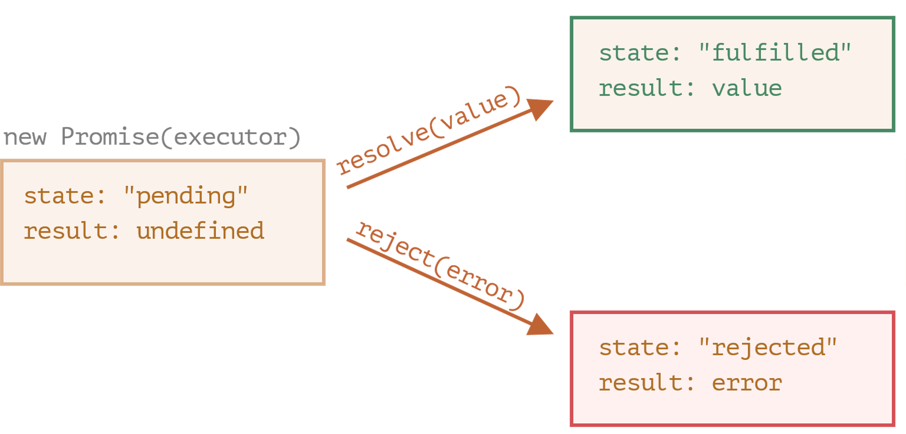
8. Promises

Slide 26
9. Classes
class UserProfile {
constructor(firstName, lastName) {
this.firstName = firstName;
this.lastName = lastName;
}
getName() {
console.log(`The Full-Name is ${this.firstName} ${this.lastName}`);
}
}
let obj = new UserProfile('John', 'Smith');
obj.getName(); // output: The Full-Name is John Smith
Notes:
https://stackblitz.com/edit/js-classes-example?file=index.js

Slide 27
10. Modules
We can use the "import" or "export" statement in a module
variables, functions, classes or any other component from/to different files and modules
Reference: https://stackblitz.com/edit/modules-example?file=index.js
// Module import and export
// file1.js
export const num = 50;
export function getName(fullName) {
//data
};
// file2.js
import {num, getName} from 'module';
console.log(num); // 50

Slide 28
11. for-of loop
This loop replaces for-in and forEach loop
Use it to loop over iterable objects such as Arrays, strings, Maps, Sets
// for-of loop
const iterable = ['a', 'b'];
for (const x of iterable) {
console.log(x);
}
const list = ['Apple', 'Pineapple'];
for (const [index, element] of list.entries()) {
console.log(`${index}. ${element}`);
}

Slide 29
12. New string properties
startsWith
endsWith
Includes
repeat
// String methods
'hello'.startsWith('hell');
'hello'.endsWith('ello');
'hello'.includes('ell');
'doo '.repeat(3);

Slide 30
13. New number properties
Number.isInteger(num)
Number.isSafeInteger(num), Number.MIN_SAFE_INTEGER, Number.MAX_SAFE_INTEGER
(within the signed 53-bit range in which there is no loss of precision)
Number.isNaN(any)
// String methods
'hello'.startsWith('hell');
'hello'.endsWith('ello');
'hello'.includes('ell');
'doo '.repeat(3);

Slide 31
14. New Math methods
Math.sign()
Math.trunc()
// Math methods
console.log(Math.sign(-8));
console.log(Math.sign(0));
console.log(Math.sign(3));
console.log(Math.trunc(3.1));
console.log(Math.trunc(3.9));
console.log(Math.trunc(-3.1));
console.log(Math.trunc(-3.9));

Slide 32
Summary

Slide 33
Summary
We learned about the ECMAScript 2015 or ES6, which defines the standard for JavaScript implementation]
We also learned about the top 10 features of ES6 which makes it very popular
ES6 provides classes, modules, arrow functions, template literals, destructuring assignments and many more features which make working with JavaScript a lot easier

Slide 34
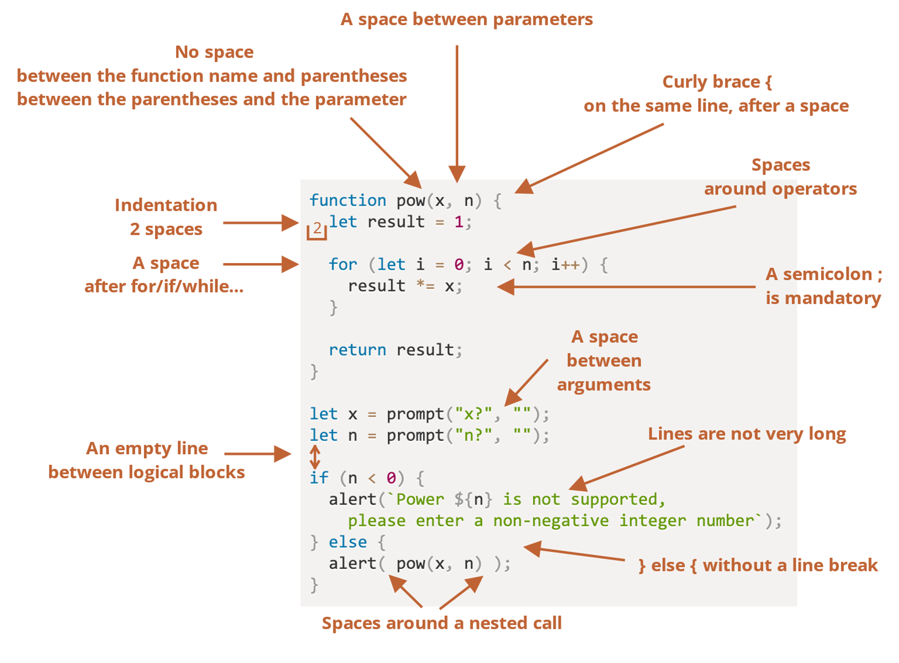
Coding style

Slide 35
Questions?

